Slide 1
Lecture 13

Slide 2
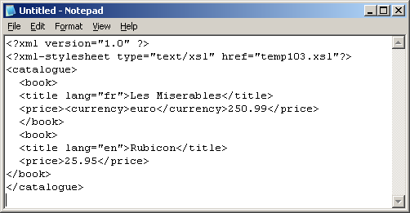
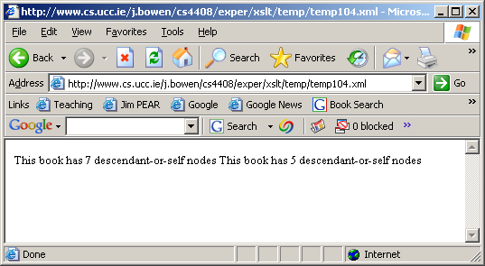
The various node tests also work on this axis: eg node()
<?xml version="1.0"?>
<xsl:transform version="1.0" xmlns:xsl="http://www.w3.org/1999/XSL/Transform">
<xsl:template match="/">
<body> <xsl:apply-templates select="./catalogue/book"/></body>
</xsl:template>
<xsl:template match="book">
This book has <xsl:value-of select="count(./descendant-or-self::node())"/> descendant-or-self nodes
</xsl:template>
</xsl:transform>
As expected, text nodes are included in the counts this time

Slide 3
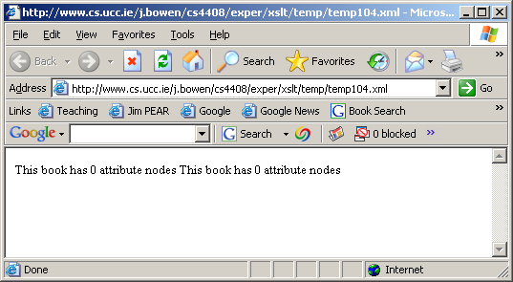
Xpath axes: the attribute axis
<?xml version="1.0"?>
<xsl:transform version="1.0" xmlns:xsl="http://www.w3.org/1999/XSL/Transform">
<xsl:template match="/">
<body> <xsl:apply-templates select="./catalogue/book"/></body>
</xsl:template>
<xsl:template match="book">
This book has <xsl:value-of select="count(./attribute::*)"/> attribute nodes
</xsl:template>
</xsl:transform>
As expected, we are told that the books have no attributes
Now, the current principal node type is attribute nodes; so the * matches attribute nodes

Slide 4
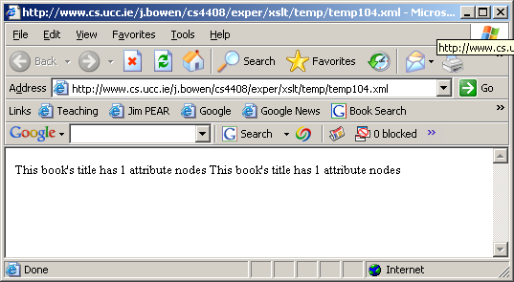
Xpath axes: the attribute axis again
<?xml version="1.0"?>
<xsl:transform version="1.0" xmlns:xsl="http://www.w3.org/1999/XSL/Transform">
<xsl:template match="/">
<body> <xsl:apply-templates select="./catalogue/book"/></body>
</xsl:template>
<xsl:template match="book">
This book's title has <xsl:value-of select="count(./title/attribute::*)"/> attribute nodes
</xsl:template>
</xsl:transform>
As expected, we are told that each book title has 1 attribute

Slide 5
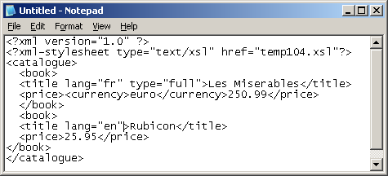
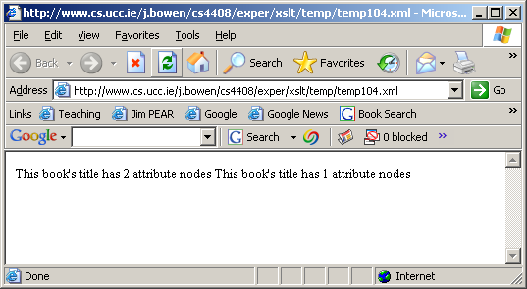
the attribute axis again: a different XML file
<?xml version="1.0"?>
<xsl:transform version="1.0" xmlns:xsl="http://www.w3.org/1999/XSL/Transform">
<xsl:template match="/">
<body> <xsl:apply-templates select="./catalogue/book"/></body>
</xsl:template>
<xsl:template match="book">
This book's title has <xsl:value-of select="count(./title/attribute::*)"/> attribute nodes
</xsl:template>
</xsl:transform>
As expected, we are told that the book titles have differing numbers of attributes

Slide 6
abbreviated reference to the attribute axis
<?xml version="1.0"?>
<xsl:transform version="1.0" xmlns:xsl="http://www.w3.org/1999/XSL/Transform">
<xsl:template match="/">
<body> <xsl:apply-templates select="./catalogue/book"/></body>
</xsl:template>
<xsl:template match="book">
This book's title has <xsl:value-of select="count(./title/@*)"/> attribute nodes
</xsl:template>
</xsl:transform>
Thus @* is an abbreviation for attribute::*

Slide 7
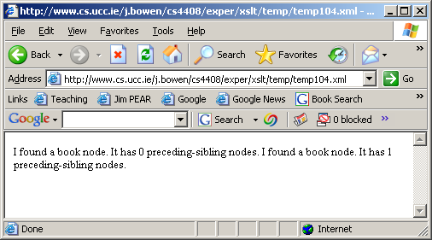
the preceding-sibling axis
<?xml version="1.0"?>
<xsl:transform version="1.0" xmlns:xsl="http://www.w3.org/1999/XSL/Transform">
<xsl:template match="/catalogue/book">
<body>I found a <xsl:value-of select="name()"/> node.
It has <xsl:value-of select="count(./preceding-sibling::*)"/> preceding-sibling nodes.</body>
</xsl:template>
</xsl:transform>

Slide 8
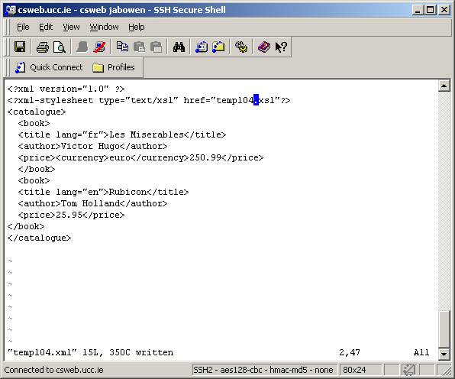
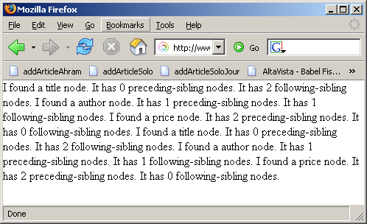
the preceding-sibling axis and following-sibling axis
<?xml version="1.0"?>
<xsl:transform version="1.0" xmlns:xsl="http://www.w3.org/1999/XSL/Transform">
<xsl:template match="/catalogue/book/*">
<body>I found a <xsl:value-of select="name()"/> node.
It has <xsl:value-of select="count(./preceding-sibling::*)"/> preceding-sibling nodes. It has <xsl:value-of select="count(./following-sibling::*)"/> following-sibling nodes.</body>
</xsl:template>
</xsl:transform>
Note that each book now has an author element

Slide 9
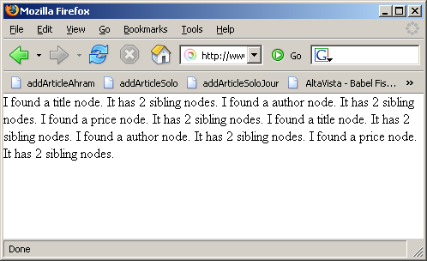
combining the sibling axes
<?xml version="1.0"?>
<xsl:transform version="1.0" xmlns:xsl="http://www.w3.org/1999/XSL/Transform">
<xsl:template match="/catalogue/book/*">
<body>I found a <xsl:value-of select="name()"/> node.
It has <xsl:value-of select="count(./preceding-sibling::*)+count(./following-sibling::*)"/> sibling nodes.</body>
</xsl:template>
</xsl:transform>

Slide 10
the namespace axis
As stated earlier, an element has a namespace node
  for every attribute on the element whose name starts with xmlns: ;
  for every attribute on an ancestor element whose name starts xmlns: unless the element itself or a nearer ancestor redeclares the prefix;
  for an xmlns attribute, if the element or some ancestor has an xmlns attribute, and the value of the xmlns attribute for the nearest such element is non-empty
In addition, every element in an XML document automatically has a namespace node for the XML namespace

Slide 11
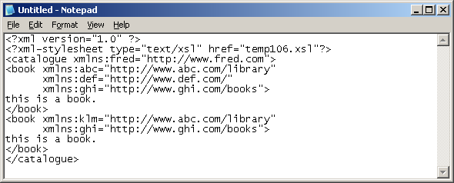
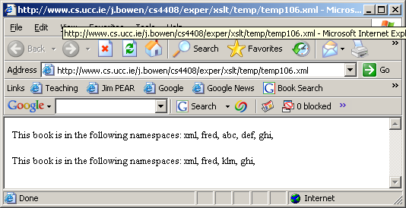
the namespace axis (contd.)
<?xml version="1.0"?>
<xsl:transform version="1.0" xmlns:xsl="http://www.w3.org/1999/XSL/Transform">
<xsl:template match="/">
<body> <xsl:apply-templates select="./*/book"/> </body>
</xsl:template>
<xsl:template match="book">
<p> This book is in the following namespaces:
<xsl:for-each select="namespace::*"> <xsl:value-of select="name()"/>,
</xsl:for-each>
</p>
</xsl:template>
</xsl:transform>

Slide 12
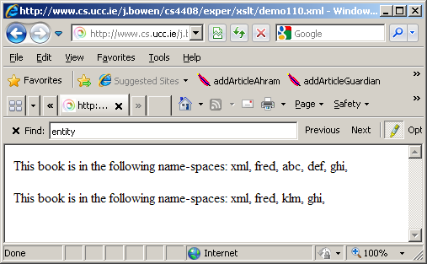
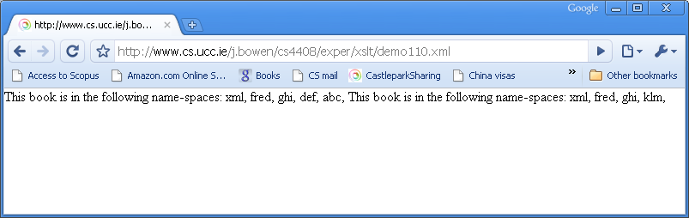
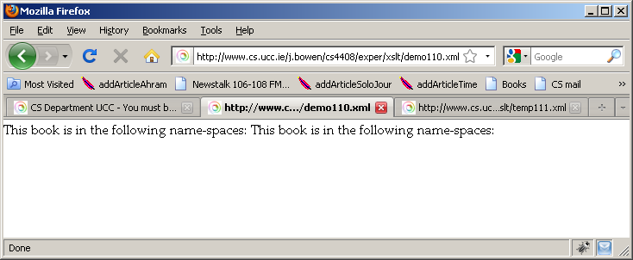
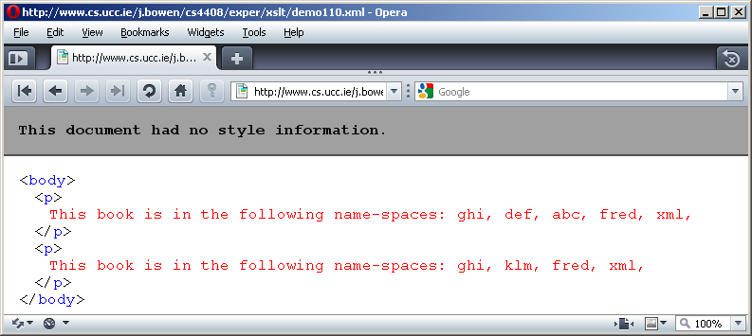
Various browsers treat the last example differently
Try it yourself: http://www.cs.ucc.ie/j.bowen/cs4408/exper/xslt/demo110.xml

Slide 13
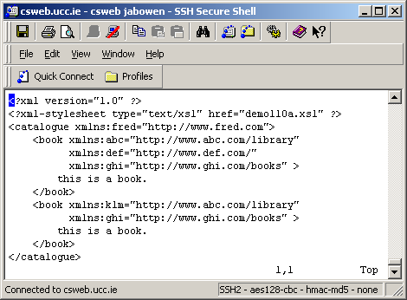
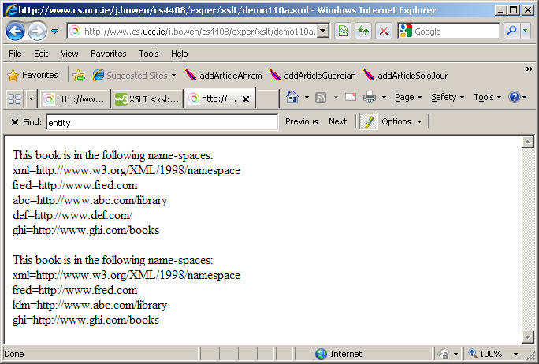
For a namespace node, name() returns the prefix but the string value of a namespace node is the URI
<?xml version="1.0"?>
<xsl:transform version="1.0" xmlns:xsl="http://www.w3.org/1999/XSL/Transform">
<xsl:template match="/">
<body><xsl:apply-templates select="./*/book"/></body>
</xsl:template>
<xsl:template match="book">
<p>This book is in the following name-spaces:
<xsl:for-each select="namespace::*">
<br/> <xsl:value-of select="name()"/><xsl:text>=</xsl:text><xsl:value-of select="."/>
</xsl:for-each>
</p>
</xsl:template>
</xsl:transform>

Slide 14
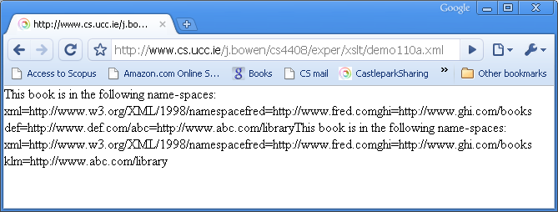
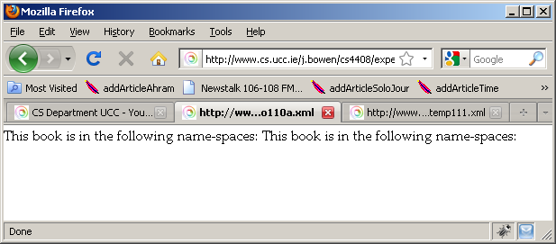
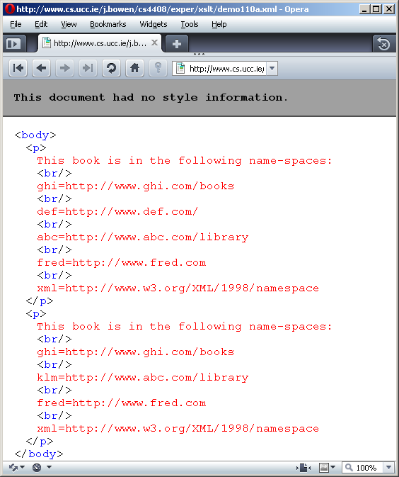
Various browsers treat the last example differently
Try it yourself: http://www.cs.ucc.ie/j.bowen/cs4408/exper/xslt/demo110a.xml

